Slide 1
Introduction to the Data Analytics – Techniques for Decision Making Certificate Program

Slide 2
Data Analysis Essentials
Day 1
Helping you through the journey
Michael Lisin (mlisin@uw.edu)
Rajini Chintalapuri

Slide 3


Slide 4
Introductions
Course Developers
Michael Lisin – media industry / MBA
Andrew L Hoover – education strategy / MBA
Greg Weber – software industry / EE
Stephen Elston – financial industry / PhD
Tip: network with each other
Course Students
Name, occupation
Experience with Excel, SQL, programming
Plans for earning certificate
What does ‘very satisfied’ look like?
If data was a food, what would it be: DISTINCT(food)?

Slide 5
Agenda
Introductions
Course Syllabus
Certificate Program
Data Driven Culture
Question Analysis
Business and Analysis Questions
Excel, Power BI, and R
Tip: start thinking about a final project

Slide 6
Course Outline
Lesson |  | Topics
0 |  | Program and Course Overview
1 |  | The overall process of making decisions using data
2 |  | Getting started with data analysis
3 |  | Data acquisition and preparation
4 |  | Data Transformation
5 |  | Grouping and Transforming Data
6 |  | Probability and Descriptive Statistics
7 |  | Hypothesis Testing
8 |  | Introduction to machine learning and data mining
9 |  | Unsupervised learning
10 |  | Final Project

Slide 7
Course Materials and Grading
Materials
Recommended textbooks…
Technical requirements
Canvas, PDF viewer, Word-processor, spreadsheet, web browser
Grading
Tip: Anaconda +
R Studio
Component | Percentage
Attendance and Participation | 10%
Lab Assignments | 30%
Quizzes and Lab exercises | 30%
Final Project | 30%

Slide 8
Program Application Requirements
Completion of at least one college level statistics course
Intermediate level of SQL Query Language Skill (Pre-Test)
At least two years of office work experience
At least two years of college education
Excel experience

Slide 9
Program Learning Outcomes
Gain fluency and experience with:
Descriptive and Inferential Statistics
Advanced Microsoft XL Data Analysis and Visualization Features
Power BI for Publishing Interactive Dashboards on the Web
R Programming for Exploring and Wrangling Data
Azure Machine Learning for Basics of Supervised and Unsupervised Learning
……so that students graduate with the essential skills to wrangle and explore data, find insights, build dashboards and make predictions or recommendations based on data from multiple sources at a departmental or functional level.

Slide 10
Stackable Certificate Program with Pathways
An Data Analytics Application Developer
Data Analytics Certificate Program
Python Programming Certificate Program
An Aspiring Data Scientist
Data Analytics Certificate Program
Python Programming Certificate Program
Data Science Certificate Program

Slide 11
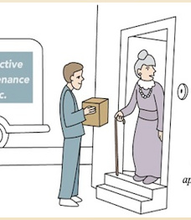
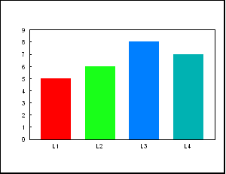
Data Analytics Market Trends
Retrospective
Analytics
“Business
Intelligence”
Predictive
Analytics
Real-Time
Analytics
KNOW what drove Historical Sales
PREDICTION like
Preventative Healthcare
RECOMMENDATIONS
and decision support
Customer who viewed
this item, also viewed….
Online shopping
Robert,
It’s for you…
apparently
your heart is
about to
fail.

Slide 12
The New Data Analytics Tool Box
Powerful, ubiquitous computing
R and Python in addition to SQL programming languages
Machine Learning
KNOW
PREDICT
RECOMMEND
Powerful Computing
Scale
Programming Languages
Machine Learning
Agility

Slide 13
Programming Languages to Wrangle & Explore Data
Spreadsheets
Swiss Army knife for smaller tasks
Structured Query Language SQL
‘Lingua Franca’ of data wrangling

Slide 14
Programming Languages to Wrangle & Explore Data
NEW Data Wrangling and Exploring Programming Languages
R – Statistical Programming Language
Python – Data Application Development Language
…..Boost productivity and speed of analysis

Slide 15
From Data Mining
to Machine Learning
Machine Learning Algorithms not only predict outcomes, but also can continue to learn and improve in real-time based on accuracy of predictions and recommendations

Slide 16
From Data Mining / Machine Learning Concepts
Supervised Learning
Regression
Classification
Unsupervised Learning
Clustering
Algorithms:
Linear regression
Logistic regression
Decision Trees
Support Vector Machines
Neural Networks
… many more

Slide 17
An Overview of the Iterative Data Analysis Process

Slide 18

Start With a Question

Slide 19
Iterative Data Analysis Process Parts
#1 Ask Questions
Wrangle Data
Explore Data
Draw Conclusion
Communicate Findings

Slide 20
1. Ask Question(s)
Hypothesis Generating Question
Open or “Why” Questions about present or past
Example: Why did sales rise in the past two quarters?

Slide 21
1. Ask Question(s)
Hypothesis Confirming Question
Yes/No Questions about the present or past
Example: Was the rise in sales in the past two quarters caused by Asia region sales growth?

Slide 22
1. Ask Question(s)
Prediction Question
“What will” or “How will” Questions about the future
Example: If we increase price by 10%, how will that impact sales volume?

Slide 23
Translate to Data Analysis Question
SALES GROWTH EXAMPLE
How did sales change over the past two quarters by:
Region
Sales Office
Sales Person
Product Line
Product
Product Feature
Using the Measures: Revenue and Units

Slide 24
2. Wrangle Data
Acquire and map each “column of data” from one “raw” form into another format with the intent of making it more appropriate and valuable for analysis

Slide 25
2. Wrangling “Data Columns”
Munge Data
Change data types
Join data fields
Clean data
Calculate measures
Remove data columns that are not useful
Apply a schema or data model
Model data

Slide 26
2. Wrangling “Data Columns”
Calculate Descriptive Statistics or Plot Data within a Column to:
Remove or treat outliers
Identify anomalies within columns
……..

Slide 27


2. Wrangle Data – SALES GROWTH EXAMPLE
Sales by
Region
Sales by
Product
Acquire
Munge
Describe
Meta Data
Exchange rate
USD to Foreign
Currency
fluctuations
Accounting
System
CRM
CMS

Slide 28
3. Explore Data
Creating Informational Views
Scatter plots
Graphs
Tables
Visual data exploration

Slide 29
3. Explore Data
Using Descriptive Statistics
Mean, median, quantiles
Using Inferential Statistics
T-Tests
Correlations
……..

Slide 30
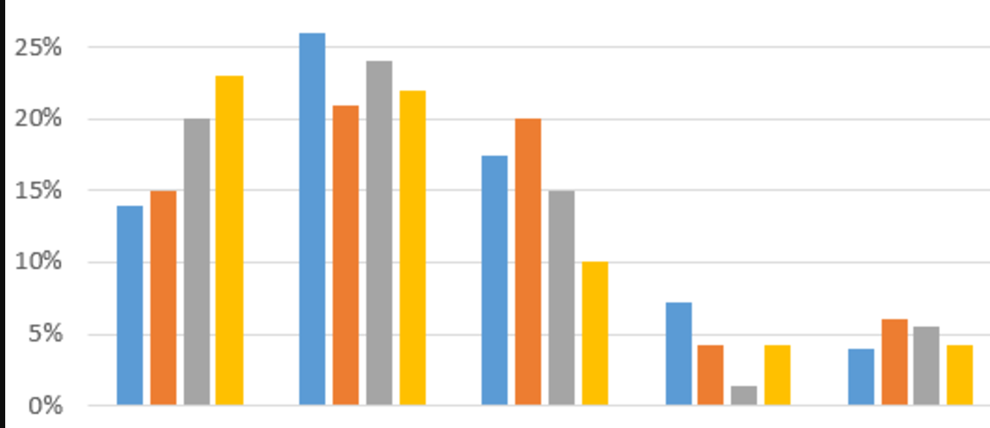


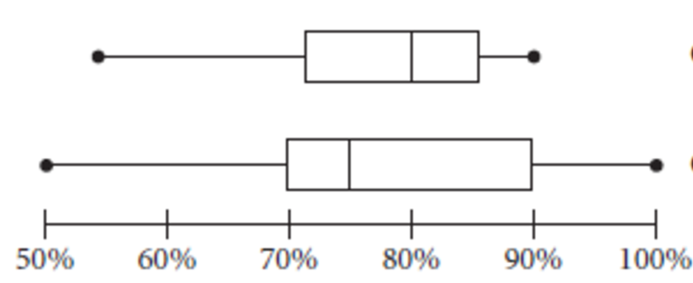
3. Explore Data – SALES GROWTH EXAMPLE
Sales by
Product
Sales by
Location
Range of Sales
Revenue Growth
By Region by Quarter
Range of Sales Growth
For Products within Three
Top Selling Product Lines
Sales by
Product Line
Sales by
Region
South
America
North
America
Asia
Europe
30

Slide 31
4. Draw Conclusion(s)
Conclusion options
Hypothesis generating question – certain | qualified | uncertain
Hypothesis confirming question – accept/reject
Prediction question – expected result or best choice with a confidence level

Slide 32
4. Draw Conclusion(s)
Review how you did your
Question translation
Data acquisition
Data wrangling work
Data exploration

Slide 33
4. Draw Conclusion(s)
When drawing conclusions note
Data access, quality and integrity issues
Methods, hypothesis and sample bias or assumptions
that could impact accuracy
Application in the future (if any)

Slide 34
5. Communicate Finding(s)
Communication is a two way dialogue that can lead to new questions
Typical Forms
Report
Digital Dashboard
Covered and practiced in next course!

Slide 35
5. Communicate Findings– SALES GROWTH EXAMPLE
Hypothesis Confirming Question – Did Asia drive sales growth?
Answer – No
Asia had flat unit sales, but revenue grew due to exchange rate fluctuations
NE US and South America drove the most revenue and unit sales growth

Slide 36
5. Communicate Findings– SALES GROWTH EXAMPLE
Hypothesis Generative Question – Why did sales increase?
Answer – 3 of our eight product lines accounted for 80% of the sales growth and four of our twenty sales offices were responsible for driving 66% of the sales growth

Slide 37

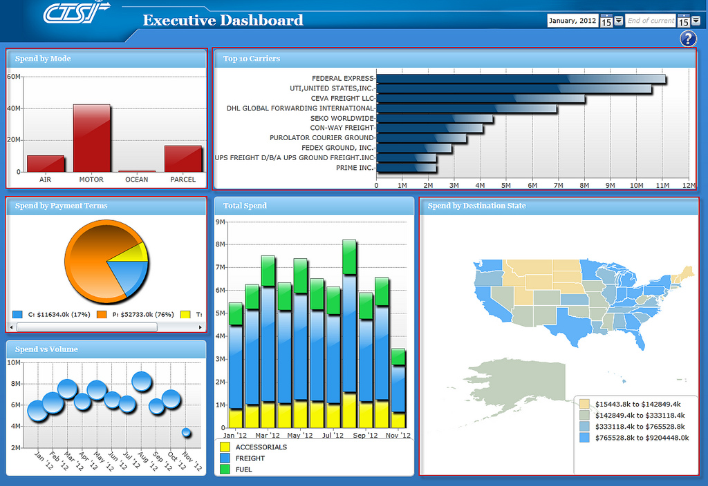


THE ITERATIVE DATA ANALYSIS PROCESS
1. Ask Question(s)
5. Communicate
Finding(s)
Business
TRANSLATION
4. Draw Conclusion(s)
Analysis
2. Wrangle
Data
3. Explore
Data
Acquisition
Data

Slide 38
Discussion
What are the job expectations for data science compared to business intelligence/data analysis skills?

Slide 39
Data Analysis Skills
Using Data to Scope and Design
the Data Analytics Certificate Program

Slide 40
Iterative Data Analysis Process Parts
Ask Question(s)
Wrangle Data
Explore Data
Draw Conclusion(s)
Communicate Finding(s)

Slide 41
Ask Questions
Precise questions from accurate sources

Slide 42
Business and Program Design Question(s)
What feature(s)
Skills and level?
Tools and proficiency level?
Knowledge and fluency level?
Pre-Requisites sufficient to complete program?
How to make program stackable?
Which tool sets appear to be most durable?

Slide 43
Addressing Business Questions
Sources
Articles, Blog Posts, Communities – ex. Kaggle.com
Advisory Board Members
Faculty and Instructors
Alumni
Program Students
Challenges
Conflicting data and information variability
Range of terminology, inconsistently used terms
Old technology and skills remain, yet being displaced
New tool and skillsets being adopted

Slide 44

Durable Data Science Skills
MATH & STATISTICS
Statistical Modeling
Experiment Design
Machine Learning
Supervised Learning:
Decision Trees
Classification
Logistic Regression
Unsupervised Learning
Clustering
……
PROGRAMMING & DATABASE
Microsoft Excel
Statistical Languages – R
Programming Languages - Python
Databases and Big Data Storage
SQL
NoSQL
Hadoop
Hive/Pig
MapReduce
Software as a Service
…..
MINDSET
Curious about data
Hacker approach
Analytical
Influence authority
Problem solver
…….
COMMUNICATION & VISUALIZATION
Translate data-driven insights into
recommendations and decisions
Digital dashboard development
Story telling skills
Visual design thinking
……..

Slide 45
Data Analysis Question
What subset of the durable data science skills would provide sufficient scope such that the data analytics program would both:
Equip graduates to put the skills into practice at the departmental level for immediate impact AND
Be a good pre-requisite for and be well aligned with Data Science

Slide 46
Wrangle Data
Job Postings

Slide 47
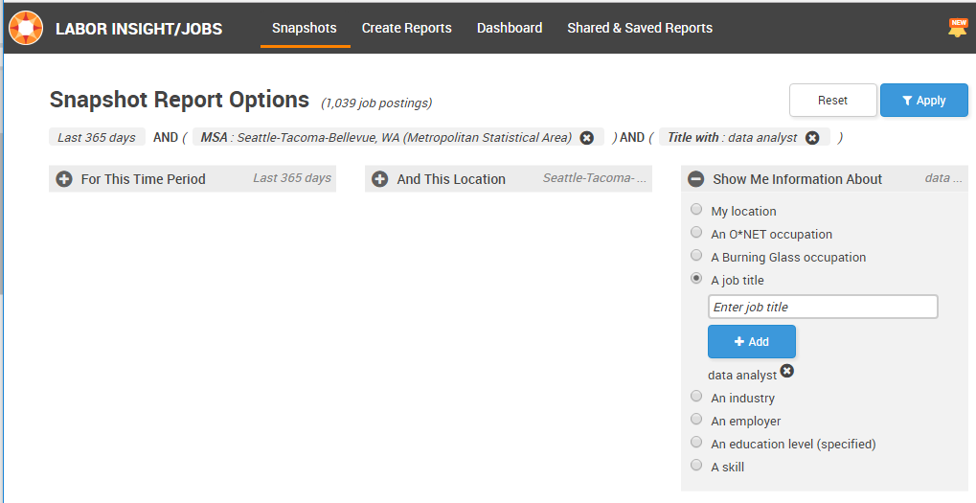
Burning Glass –
Labor Insight/Job Dashboard

Slide 48
Labor Insights – Data Wrangling Issues
No higher level job categories
for example all analysts
No skill level included
(ex. Excel novice = Excel expert)
Lack relative importance of skills in each job posting
Omission of key data like salary level for many postings
Growth rates are likely exaggerated over time

Slide 49
Explore Data
From Seattle Metro Area

Slide 50
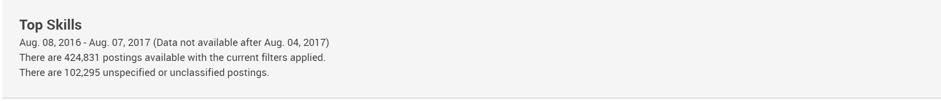
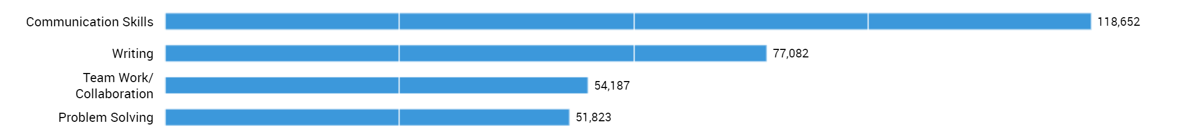

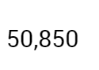
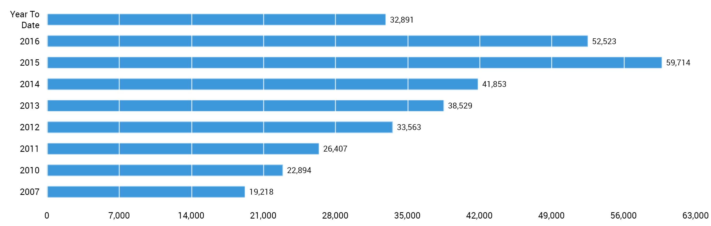
Five Most Sought After Skills
Microsoft Excel is the
5th most sought after
job skill overall!
While still a very widely sought after skill, XL appears to have plateaued in terms of the frequency it is mentioned
on job postings/
Microsoft Excel - Number of Postings per Year

Slide 51
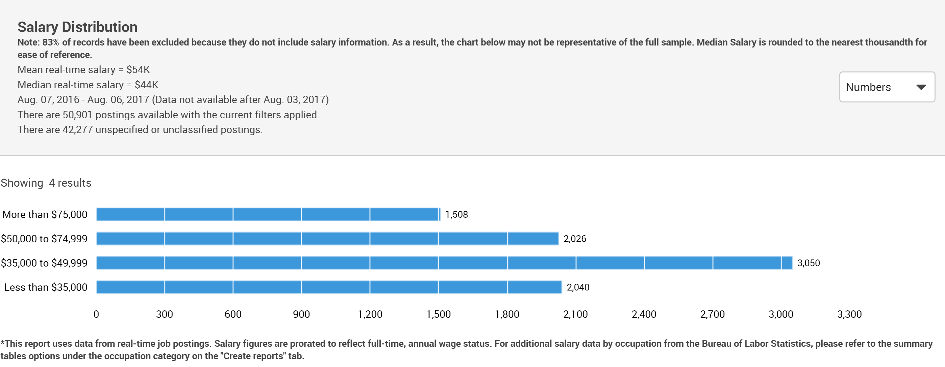
Salary Levels for Excel Skills
50% of the jobs pay $44K or less
Issue: No differentiation in Excel skill level

Slide 52
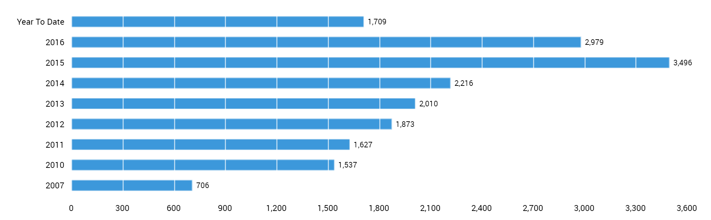
SQL & Data Analysis Skill Postings
Microsoft SQL + Data Analysis Skilled Job Postings
Postings that concurrently listed SQL and Data Analysis more than doubled in 5 years [2010 – 2015]

Slide 53
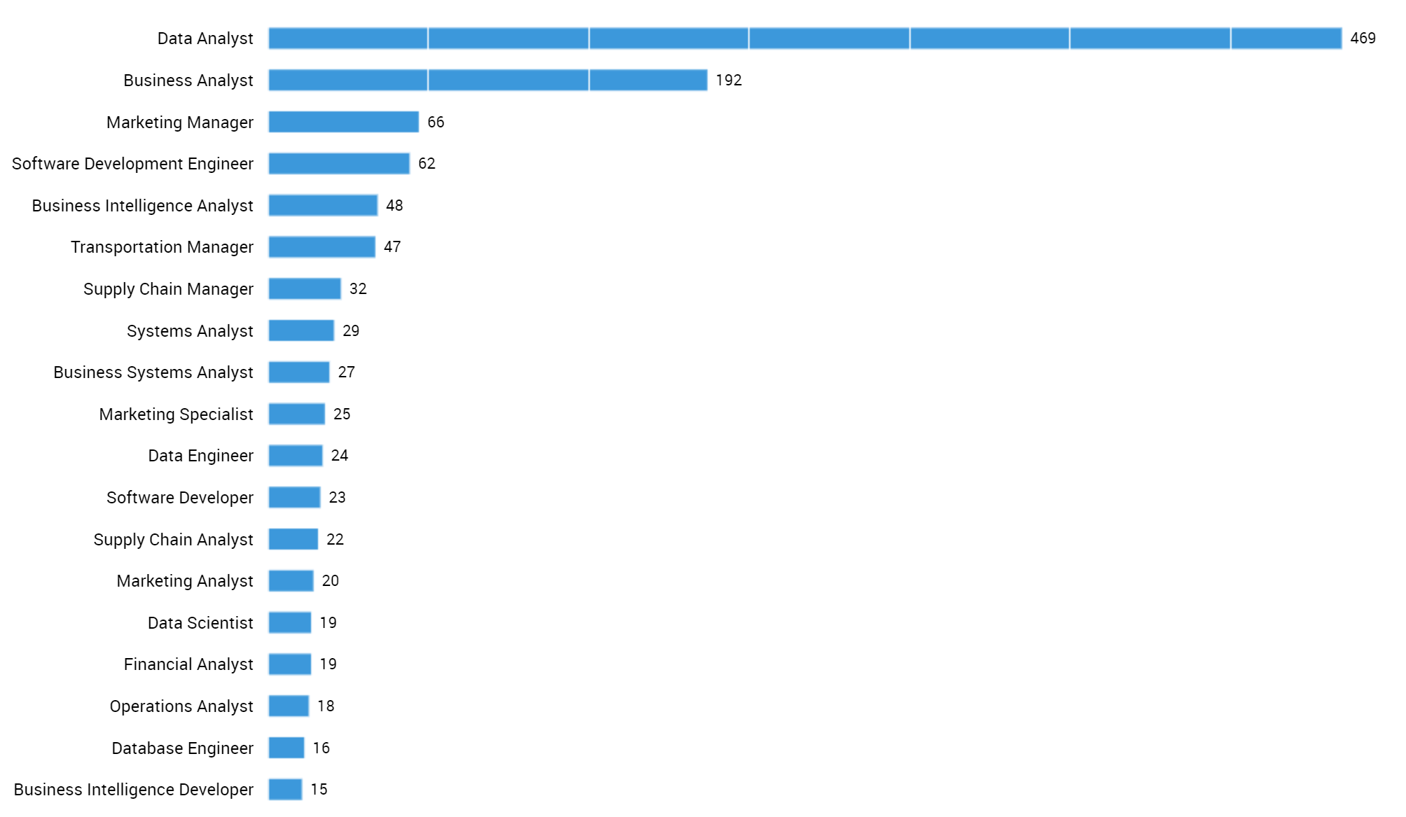
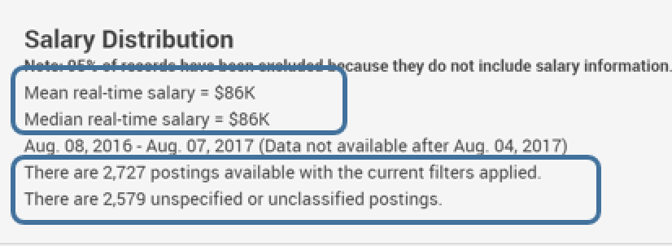
SQL & Data Analysis Skill Postings
Job Titles
Excel median pay $44K
SQL & Data Analysis median pay 86K

Slide 54
Ask more questions
Ask Questions ← →Explore Data

Slide 55
What about new or more advanced tools?
Statistical Languages
R vs. SAS, SPSS or S
Programming Languages
Python vs. Julia, Matlab, C, Java
Machine Learning Algorithms
What are the trends?
How do these technologies improve salary outlook?

Slide 56
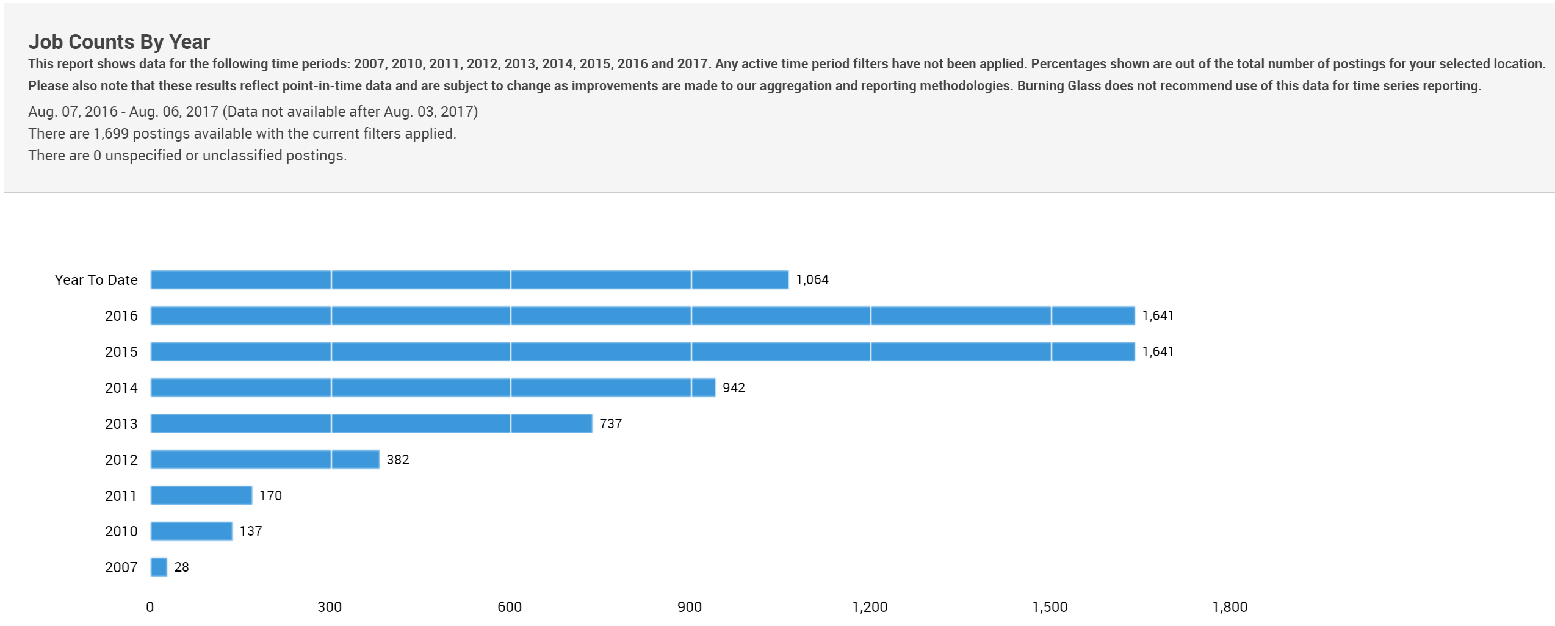

Growth in R Programming
737 jobs in 2013, 1641 jobs in 2015

Slide 57
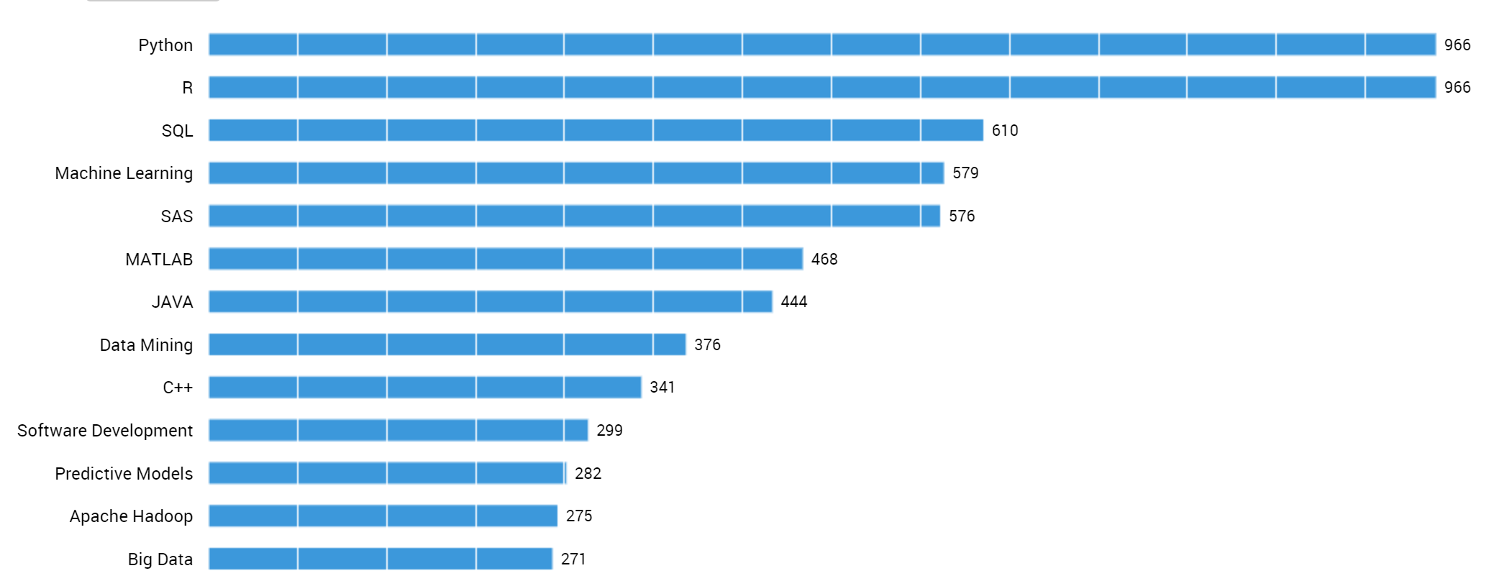
Python and R Co-Occurring Skills
7.6k jobs with Data Analysis skills
1.4k jobs with Data Science skills
966 positions requiring both R and Python skills

Slide 58
Draw Conclusions
Combine the answers and apply to original question

Slide 59
Data Analytics Topics:
Covered | Introduced |Deferred
MATH & STATISTICS
Statistical Modeling
Experiment Design
Machine Learning
Supervised Learning:
Decision Trees
Classification
Logistic Regression
Unsupervised Learning
Clustering
……
PROGRAMMING & DATABASE
Microsoft Excel
Statistical Languages – R
Programming Languages - Python
Databases and Big Data Storage
SQL
NoSQL
Hadoop
Hive/Pig
MapReduce
Software as a Service
…..
MINDSET
Curious about data
Hacker approach
Analytical
Influence Authority
Problem Solver
…….
COMMUNICATION & VISUALIZATION
Translate data-driven insights into
recommendations and decisions
Digital dashboard development
Story telling skills
Visual design thinking
……..

Slide 60
Iterative Data Analysis Process Parts
Ask Question(s)
Wrangle Data
Explore Data
Draw Conclusion(s)
Communicate Finding(s)

Slide 61
Data Analysis Skills
An applicable exercise in Data Analysis Process

Slide 62
Data Driven Culture
Fostering a Data Driven Culture and Organizational Capabilities

Slide 63
Organizational Culture and Groups
Organizational culture
Environment for group interactions
How decisions are made
How expectations are set
How people collaborate
Organizational groups
Business group
Analysis group
Data group

Slide 64
Business Group
Beginning
Unfocused questions
Unrealistically high expectations
Example: “Maximize profits”
Mature
Focused questions
Matches overall organizational capabilities
Example: “Last 12 months of revenue by product”

Slide 65
Analysis Group
Beginning
Ad hoc reports
Manual spreadsheets
Descriptive analytics
Mature
Predictive analytics
Machine learning models
Optimization

Slide 66
Data Group
Beginning
Low quality data
Disparate systems
Difficult to join / conform data
Mature
High quality data
Data warehouse with conformed data
Data wrangling and cleansing in data warehouse
Self-serve data access for business users

Slide 67
Assessing Organizational Level
Analysis group
Reporting
Interactive dashboards
Descriptive insights
Predictive models
Sample question: “Provide examples of recent insights”

Slide 68
Assessing Organizational Level
Data group
Structure of source data
Data warehouse dimensions and facts
Sample question: “How is the source data structured?”
Data warehouse question: “Do you have slowly changing dimensions?”

Slide 69
Discussion Exercise
What is the most likely organizational maturity level from a data perspective given the expectations of the business?
If the business asks…

Slide 70
Provide insights that would allow me to optimize my profits.
Beginning
Intermediate
Advanced
Beginning

Slide 71
Provide monthly revenue for the last 12 months including month over month percent delta for the products launched last year.
Beginning
Intermediate
Advanced
Intermediate

Slide 72
What is the expected amount of revenue next quarter for our current products in market?
Beginning
Intermediate
Advanced
Advanced

Slide 73
What will the market share be for the new product we will be launching, at 12 months after launch?
Beginning
Intermediate
Advanced
Advanced

Slide 74
What is the right mix of marketing spend over our various marketing channels to minimize our cost per acquisition?
Beginning
Intermediate
Advanced
Advanced

Slide 75
What contributed to that upward spike in sales last month?
Beginning
Intermediate
Advanced
Intermediate

Slide 76
Discussion Debrief
Data Learning Curve
Beginning Org
Answers magically materialize from data
Advanced Org
Capability to answer prediction and optimization questions

Slide 77
Question Analysis
Translating Business Problems Into Analytical Questions

Slide 78
Asking Questions
Understand the business problem and translate that into analytical questions

Slide 79
The First Step: Scoping the Business Problem
Specific to a problem within a defined area of the business
What features do customers value most?
Which ads are driving the most sales growth?
Why are margins down for a given product line?

Slide 80
Scoping the Business Problem – Beginning Organization
Match expectations to organizational capabilities
Beginning organizational capability
Business problems are too general
Too far reaching for the organizational capability
Example: “Determine the lifetime value of my customers”
Right-sizing problem scope
From general optimization to specific descriptive analytics
Determine specific business decisions
Describe data needed to support these decisions

Slide 81
Scoping the Business Problem – Intermediate Organization
Move from reports to insights
Example: “What do you find useful in these reports?”
Improve reports to more directly support business decisions
Increase understanding of the business

Slide 82
Scoping the Business Problem – Advanced Organization
Predictive models and optimization
Larger business impact
High Standard
High expectations from business and high trust
High accuracy and confidence analysis
Predictable schedule
Reproducible research and tested

Slide 83
Data Exploration
After data problem is scoped that matches our capabilities

Slide 84
Data Exploration – Beginning Organizational Capability
More time consuming
Finding the data
Getting access to data
Connecting / joining data
Wrangling / cleansing data
Discovering the data skeletons
Hidden data

Slide 85
Data Exploration – Intermediate Organizational Capability
Less time consuming
Experience with the data sources
Moving from spreadsheets to coding
Starting to reuse code

Slide 86
Data Exploration – Advanced Organizational Capability
Mastered source data
Data warehouse with data wrangling and cleansing
Calculated measures to support analytics

Slide 87
Communication
Collaborating with the data and business groups regularly on progress and issues

Slide 88
Communication With Business Group
Analysis assumptions & approximations
Correlation != causation
Beginning & intermediate org levels
Data won’t be perfect, but use it anyway
Less important than to advanced org level
Advanced org level
includes corner cases and higher accuracy

Slide 89
Communication With Data Group
Because of missing data and data quality issues:
Data Wishlist
Higher detailed data granularity
Calculated measures
Using a Data Warehouse
Data wrangling and cleansing logic
Self-serve reporting

Slide 90
Knowing When You Are Done
How do you know when you are done?
Does it answer the business question?
Is it accurate enough?

Slide 91
Documentation
Assumptions and approximations
Data wish list
Completion time
Setup or model retraining steps

Slide 92
Business and Analysis Questions
Understanding the Business and Analysis Questions

Slide 93
Business Questions
Relationships and dependencies
Can you explain this pattern?
Spikes
Trends
Drops
Historical data
Performance
Analytical patterns

Slide 94
Business Questions Lingo
Categorizations and Terminology
Different than source data
Balance source data traceability with business terminology
Use business categories and terminology when communicating insights to the business
Ongoing discovery and refinement

Slide 95
Analysis Questions
Machine learning algorithm to determine most useful features
Analyst determines most useful features

Slide 96
Data Analysis Questions
Collaborating With the Data Group

Slide 97
Data Analysis Questions
Can I trust the data?
Any data quality issues?
Any data anomalies?
Where can I find the data for <x, y, or z>?

Slide 98
Data Analysis Questions
How can I get access to the data?
Any missing data?
How is the data captured?
Timestamps
client or server time
time zone
represents what activity, start or completion?

Slide 99
Data Analysis Questions
Build relationship with data group
Get on the inside communications of the issues

Slide 100
Summary
Manage organizational expectations
Understand the question before exploring the data
The business need
The analytical question
Know the limitations of the data

Slide 101
Excel, Power BI, and R
Positioning of Excel, Power BI and R in This Course

Slide 102
Expectation of Experience
 | Excel | SQL | R
CSV
Data Tables
Graphs

Slide 103
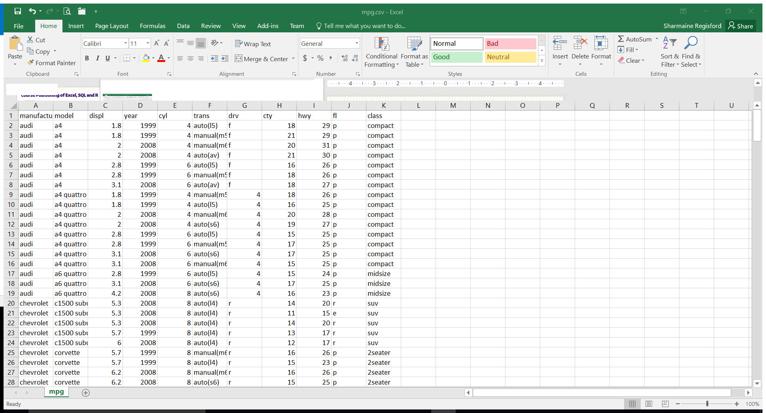
Excel 2016
Existing Excel skill and experience
Exercises in both Excel and R to compare and contrast
Excel to confirm R solution is correct
Excel phased out during course

Slide 104

Structured Query Language
Existing SQL skill and experience
Image source: SQL Documentation

Slide 105

R Programming Language
No prior R experience
No programming experience
Import from Excel and SQL into R
Image source: R.project.org

Slide 106

Power BI
No Power BI in this course
Power BI is the focus of Data Visualization course
Integration with R
Data visualization using ggplot
Data wrangling using dataframe
Image source: PowerBI Microsoft

Slide 107
Jupyter Notebook Environment

Slide 108
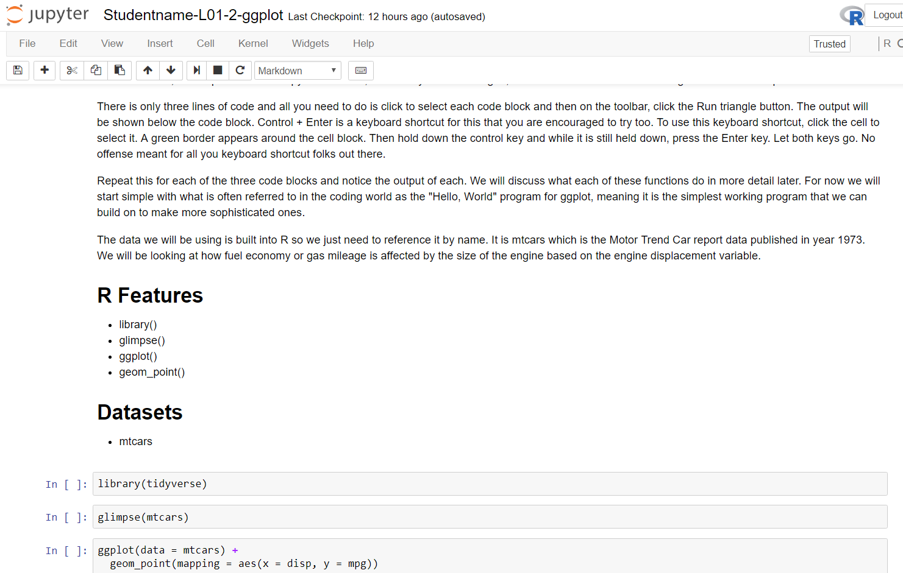

Slide 109
Accessing Virtual Labs

Slide 110
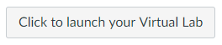
From the Labs page in the Lesson
Every lesson has labs.
You can also bookmark the location

Slide 111
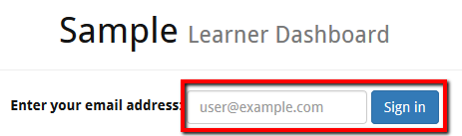
Learner Dashboard
Use an email address you will remember.
This is your “login”

Slide 112
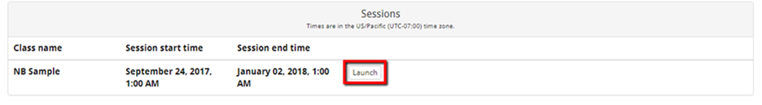
Launch the session
Launch Part 1 to activate the session.
It will say deploying for a few seconds

Slide 113
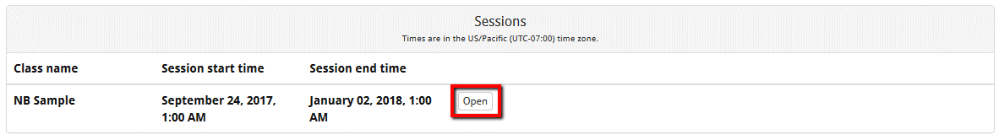
Open your session
Once launched, the session is active.
Will expire at the end time.
All data is lost.

Slide 114
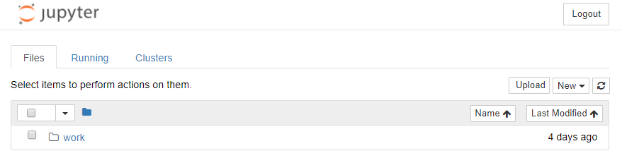
Your Jupyter Environment
These are your notebooks.
Instructors can only access if you give them the URL.

Slide 115
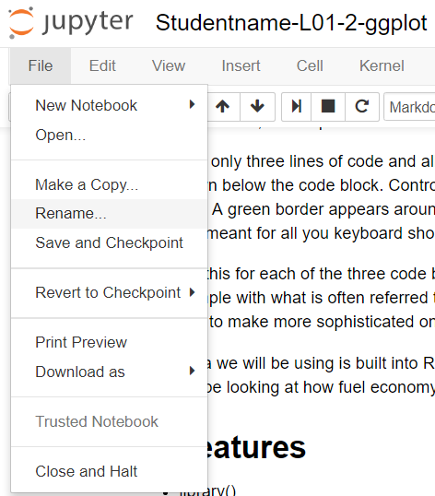
Rename your notebook
All notebooks start off alike
Studentname-L01-2-ggplot
Rename with your name.

Slide 116
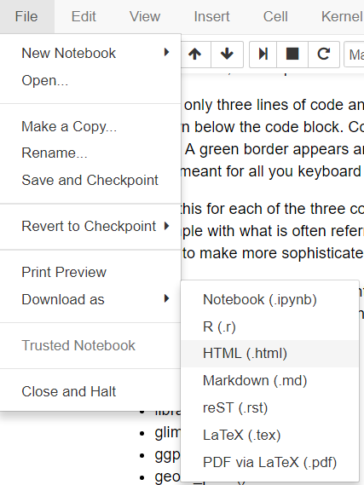
Submitting Assignments
Download as an HTML copy of your completed Notebook.
Static copy HTML file
Submit the URL as a Comment

Slide 117
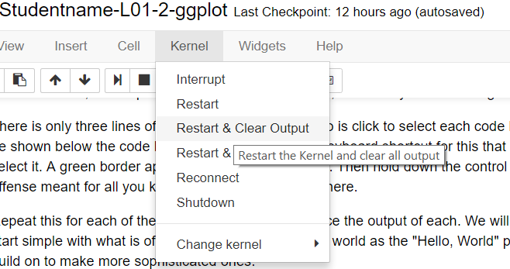
Reverting your notebook.
You can Save Checkpoints
You can also Restart & Clear Output

Slide 118
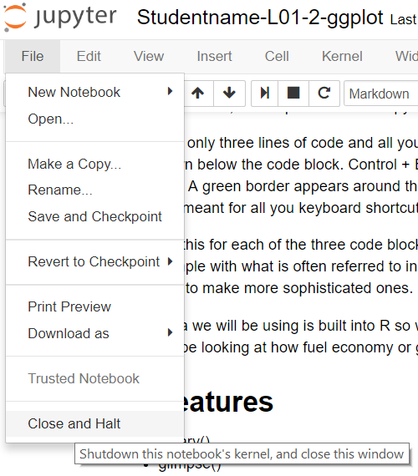
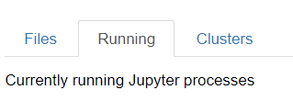
Remember to Shutdown
Running notebooks take up memory space on the server.
Close and Halt
Or Shutdown from main console

Slide 119
Summary
Have fun learning how to program in R.
Rely on your Excel skills for understanding what things will look like.

